Slide 1
Flight Price Prediction
Prepared by: Bhumik P Shah

Slide 2
Conceptual Background of the Domain Problem
Anyone who has booked a flight ticket knows how unexpectedly the prices vary.
The cheapest available ticket on a given flight gets more and less expensive over time.
This usually happens as an attempt to maximize revenue based on below findings
1) Time of purchase patterns(making sure last minute purchases are expensive)
2) Keeping the flight as full as they want it (raising prices on flight which is filling up in order to reduce sales and hold back inventory for those expensive last-minute expensive purchases).

Slide 3
Motivation for the Problem Undertaken
We could inform the travellers with the optimal time to buy their flight tickets based on the historic data and also show them various trends in the airline industry we could help them save money on their travels.

Slide 4
Data Sources and their formats
The data is collected from easemytrip.com for the duration 05.10.2021 to 13.10.2021 for the flights available between Delhi as a source location and Mumbai as a destination location using web scrapping tool selenium.
The dataset contains 1796 records (rows) and 9 features (columns) with price feature being the target attribute.
All the features in this dataset are of object datatype.

Slide 5
Data Preprocessing
Extracting out new features named as Journey_date and Journey_month from the existing feature journey_date and finally dropping the feature journey_date as all the useful information is extracted.
On the similar lines new features depart_hour and depart_min are extracted from the existing feature departure_time and finally dropping the feature departure_time as all useful information is extracted.
Similarly new features named as arrival_hour and arrival_minute are extracted from the existing feature arrival_time and finally dropping the feature arrival_time as all useful information is extracted.
The feature duration i.e time taken to reach from source to destination is having hours and minutes in records so the same is converted entirely into minutes from hours say for example if it is 2 hours and 15 minutes it is converted into 135 minutes for better visualization purpose.

Slide 6
Outliers detection and Treatment
Data Visualization is the graphical representation of the information and data. Further, by using visual elements like charts, graphs and maps data visualization tools provide an accessible way to see and understand trends, outliers and patterns in data.
The outlier detection is carried out using boxplot and distribution plot.
Further, the outliers are not treated as the total_stops can be 1 or more and the same is for duration feature as the duration to reach from source to destination can be more than 24 hours.

Slide 7
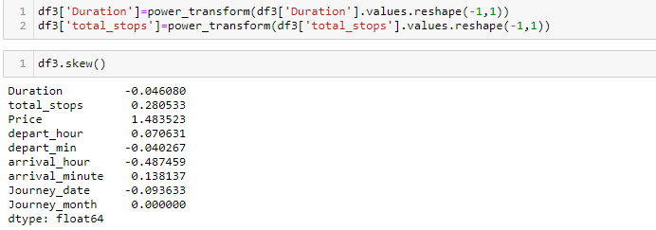
Skewness
Skewness is the degree of distortion from a normal distribution.
If the values of a certain independent variables (features) are skewed, depending on the model, skewness may violate model assumptions or may impair the interpretation of feature importance.
The features duration and total_stops are having skewness greater than 0.5 which is treated using power transform method.

Slide 8
Correlation
Correlation is an indication about the changes between two variables.
As per the heatmap it can be said that the target/label attribute Price is having positive linear correlation with features Duration and total_stops.
The feature journey_month is dropped from the dataset as the entire data is extracted for the month of October so there is no variation in the data resulting into no correlation with target attribute price.

Slide 9
Training the Model
The categorical columns are converted into numeric type using label encoder.
Standard Scaling is applied first before splitting the data into train_test_split.
The various algorithms like Linear Regression, Decision Tree Regressor, SVR, K Neighbors Regressor, Ada Boost Regressor, Gradient Boosting Regressor, Random Forest Regressor, Lasso , Ridge are used.
First approach is to find r2 score using all mentioned algorithms and finding the best model amongst it.
The cross validation is carried out for all the mentioned algorithms to help us find the best model.

Slide 10
Model Performance
Model Name | r2_score | cross_val_score | difference
Linear Regression | 0.29 | 0.23 | 0.06
Decision Tree Regressor | 0.63 | 0.42 | 0.21
SVR | -0.05 | -0.08 | 0.03
K Neighbors Regressor | 0.51 | 0.48 | 0.03
Ada Boost Regressor | -0.21 | -0.11 | -0.1
Gradient Boosting Regressor | -0.21 | 0.46 | -0.67
Random Forest Regressor | 0.72 | 0.6 | 0.12
Lasso | 0.29 | 0.23 | 0.06
Ridge | 0.29 | 0.23 | 0.06

Slide 11
Hyper Parameter Tuning
The difference between r2 score and cross validation score is minimum for KNeighborsRegression.
To find the best models amongst these can be done using Hyper tuning where the parameters are tuned to get better r2_score as compared to the one’s without tuning.
Based on Hypertuning KNeighborsRegression is my best model with r2_score of 58%.

Slide 12
Thank You

